Slide 1
2018 Camp Webinar BOY SCOUT CAMPS
APRIL 25, 2018 @ 7:30PM CST Bay-Lakes Council Facebook Page

Slide 2
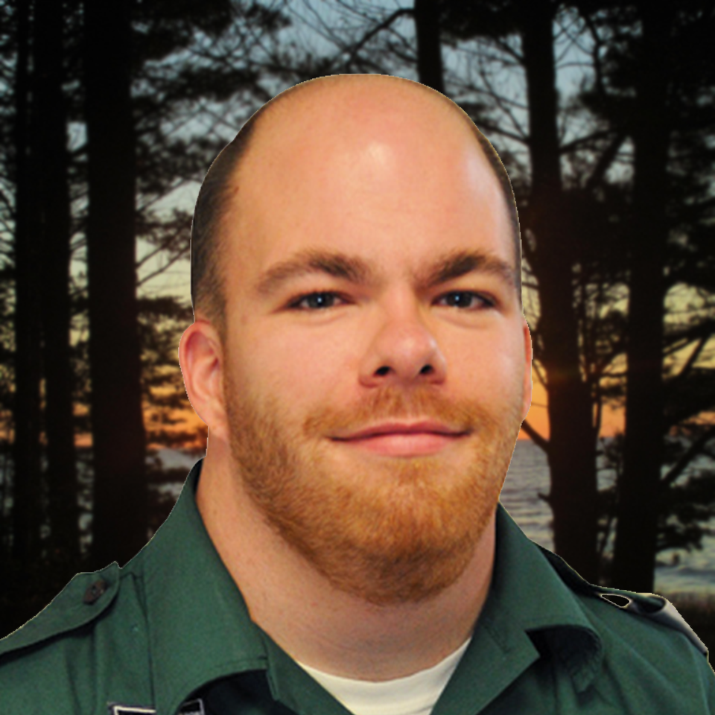
WELCOME
Hosts
Questions
Type your questions in the comments section of this live video. We’ll answer questions at the end of the presentation, in the order that they were received.
Wrap-up Time
This webinar will end at 8:25PM. Any unanswered questions will be answered on Thursday, March 22. A link to all questions and answers will be posted to the Bay-Lakes Council Facebook page.
BRYAN COMBS Council Experience Manager
Bryan.Combs@Scouting.org
MIKE ALBERTS Council Sr. Experience Manager
Michael.Alberts@Scouting.org
BOY SCOUT WEBINAR | APRIL 25, 2018

Slide 3
AGENDA
Welcome ✓
Important Updates
Session Dates
Important Dates
Pricing
Registration
Health Forms
Arrival Process
Q&A Session
BOY SCOUT WEBINAR | APRIL 25, 2018

Slide 4
IMPORTANT UPDATES
NEW YOUTH PROTECTION POLICY
Effective for the 2018 BSA summer camp season, any adult accompanying a Boy Scout Troop to a residence camp must be registered as a leader, including completion of a criminal background check and youth protection training, even if they are the parent of a youth on the trip.
BOY SCOUT WEBINAR | APRIL 25, 2018

Slide 5
IMPORTANT UPDATES
PROGRAM REGISTRATION UPDATE
Gardner Dam Scout Camp:
First Year Camper Program registration is online
ATV Sign-Up is online
Bear Paw Scout Camp:
Provisional Week Sign-Up online
PRE-REQUISITES UPDATE
First-Aid Merit Badge requirement 2d now 5
BOY SCOUT WEBINAR | APRIL 25, 2018

Slide 6
SESSION DATES
Bear Paw Scout Camp |  | Gardner Dam Scout Camp |  | Camp Hiawatha
Session 1 | June 24 – 30 | Session 1 | June 24 – 30 | Session 1 | July 8 – 14
Session 2 | July 1 – 7 | Session 2 | July 1 – 7 | Session 2 | July 15 – 21
Session 3 | July 8 – 14 | Session 3 | July 8 – 14 | Session 3 | July 22 – 28
Session 4 | July 15 – 21 | Session 4 | July 15 – 21
Session 5 | July 22 – 28 | Session 5 | July 22 – 28
Session 6 | July 29 – Aug 4 | Session 6 | July 29 – Aug 4
BOY SCOUT WEBINAR | APRIL 25, 2018

Slide 7
IMPORTANT DATES
March 1, 2018 | $100 per Scout Deposit Due
March 1, 2018 | Campership Forms Due
March 21, 2018 @ 7:30PM CST | 2018 Camp Webinar
April 25, 2018 @ 7:30PM CST | 2018 Camp Webinar
May 1, 2018 | Full Payment Due to Qualify for Early Bird
May 2, 2018 | Regular Pricing Goes into Effect
June 1, 2018 | Special Dietary Requests Deadline
August 10, 2018 | Refund Request Deadline
BOY SCOUT WEBINAR | APRIL 25, 2018

Slide 8
PRICING
 | BEAR PAW SCOUT CAMP | GARDNER DAM SCOUT Camp | CAMP HIAWATHA
EARLY BIRD PRICING
Youth | $325 | $325 | $310
Adults (18+) | $160 | $160 | $160
Adults Per Day | $27 | $27 | $27
REGULAR PRICING
Youth | $360 | $360 | $345
Adults (18+) | $195 | $195 | $195
Adults Per Day | $33 | $33 | $33
Early Bird Pricing
To lock in our early bird pricing, individuals (youth or adult) must make full payment no later than May 1. Please be advised that checks must be postmarked by May 1 to obtain early bird pricing.
Regular Pricing
Regular pricing of an additional $35.00 will go into effect on May 2 for individuals not yet paid in full but have previously registered.
BOY SCOUT WEBINAR | APRIL 25, 2018

Slide 9
REGISTRATION
Go to http://baylakescamps.org/boy-scouts-summer-camp
Select the camp you are attending
Select “Make a Reservation”
Select what week to attend
BOY SCOUT WEBINAR | APRIL 25, 2018

Slide 10
HEALTH FORMS
Only BSA Health Forms will be accepted
Part A, B, & C is required
If a Scout needs to depart camp early, don’t forget to fill out the bottom of Part A.
Don’t forget about the tetanus shot!
Youth and adults must have received the shot within the past 10 years
Mail your unit’s BSA Health Forms to camp 2 weeks prior to arrival
Bear Paw Scout Camp 14000 Bear Paw Camp Ln.
Mountain, WI 54149
Camp Hiawatha E6350 Doe Lake Road
Munising, MI 49862
Gardner Dam Scout Camp N2940 Gardner Dam Rd.
White Lake, WI 54491
BOY SCOUT WEBINAR | APRIL 25, 2018

Slide 11
ARRIVAL PROCESS
Units will be assigned an arrival time
PLEASE, PLEASE, PLEASE…arrive as a unit
Medications dropped off at check-in
Medications must be in their original prescription container
BOY SCOUT WEBINAR | APRIL 25, 2018

Slide 12
Q&A
Type your questions in the comments section of this live video. We answer questions in the order that they are received.
BOY SCOUT WEBINAR | APRIL 25, 2018

Slide 13
THANK YOU
BRYAN COMBS Council Experience Manager
Bryan.Combs@Scouting.org
920-734-5705 ext. 137
MIKE ALBERTS Council Sr. Experience Manager
Michael.Alberts@Scouting.org
920-734-5705 ext. 116
LAURA DAIGLE Experience Support Representative
Laura.Daigle@Scouting.org
920-734-5705 ext. 142
SEE YOU AT CAMP!
BOY SCOUT WEBINAR | APRIL 25, 2018

