Slide 1
2018 Camp Webinar CUB SCOUT & WEBELOS CAMPS
April 25, 2018 @ 6:30PM CST Bay-Lakes Council Facebook Page
Not Attending Cub Scout or Webelos Camp?
Our Boy Scout Camp Webinar will begin at 7:30PM CST on April 25, 2018.

Slide 2
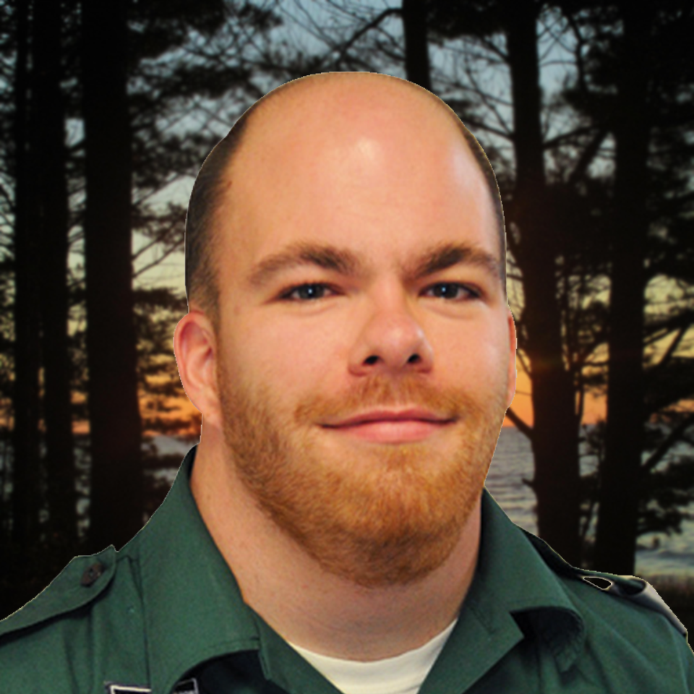
WELCOME
Hosts
Questions
Type your questions in the comments section of this live video. We’ll answer questions at the end of the presentation, in the order that they were received.
Wrap-up Time
This webinar will end at 7:25PM. Any unanswered questions will be answered on Thursday, April 25. A link to all questions and answers will be posted to the Bay-Lakes Council Facebook page.
BRYAN COMBS Council Experience Manager
Bryan.Combs@Scouting.org
MIKE ALBERTS Council Sr. Experience Manager
Michael.Alberts@Scouting.org
CUB SCOUT & WEBELOS WEBINAR | APRIL 25, 2018

Slide 3
AGENDA
Welcome ✓
Session Dates
Important Dates
Pricing
Registration
Passport to Adventure Theme
Health Forms
Arrival Process
Q&A Session
CUB SCOUT & WEBELOS WEBINAR | APRIL 25, 2018

Slide 4
SESSION DATES
Cub Scout World |  | Twin Lakes Scout Camp |  | Camp Hiawatha
Session 1 | June 24 – 27 | Session 1 | June 24 – 27 | Session 1 – WEB | June 24 – 27
Session 2 | June 27 – 30 | Session 2 | June 27 – 30 | Session 2 - CUB | June 27 – 30
Session 3 | July 8 – 11 | Session 3 | July 8 – 11
Session 4 | July 11 – 14 | Session 4 | July 11 – 14
Session 5 | July 15 – 18 | Session 5 | July 15 – 18
Session 6 | July 18 – 21 | Session 6 | July 18 – 21
Session 7 | July 22 – 25 | Session 7 | July 22 – 25
Session 8 | July 25 – 28 | Session 8 | July 25 – 28
Session 9 | July 29 – Aug 1 | Session 9 | July 29 – Aug 1
Session 10 | August 1 – 4 | Session 10 | August 1 – 4
Session 11 | August 5 – 8 | Session 11 | August 5 – 8
Session 12 | August 8 – 11 | Session 12 | August 8 – 11
CUB SCOUT & WEBELOS WEBINAR | APRIL 25, 2018

Slide 5
IMPORTANT DATES
March 1, 2018 | Campership Forms Due
March 21, 2018 @ 6:30PM CST | 2018 Camp Webinar
April 25, 2018 @ 6:30PM CST | 2018 Camp Webinar
May 1, 2018 | Full Payment Due to Qualify for Early Bird Price
May 1, 2018 | Rosters Due
May 1, 2018 | T-Shirt Sizes Due (Cub Scout World and Hiawatha Only)
May 2, 2018 | Regular Pricing Goes into Effect
June 1, 2018 | New Scout Pricing Deadline
June 1, 2018 | Special Dietary Requests Deadline
August 10, 2018 | Refund Request Deadline
CUB SCOUT & WEBELOS WEBINAR | APRIL 25, 2018

Slide 6
PRICING
 | Cub Scout World | Twin Lakes Webelos Camp | CAMP HIAWATHA
EARLY BIRD PRICING
Youth | $170 | $170 | $130
Adults (18+) | $170 | $170 | $90
Adults Per Day | $57 | $57 | $30
REGULAR PRICING
Youth | $205 | $205 | $165
Adults (18+) | $205 | $205 | $125
Adults Per Day | $63 | $63 | $36
CUB SCOUT & WEBELOS WEBINAR | APRIL 25, 2018

Slide 7
REGISTRATION
Go to http://baylakescamps.org/cub-scouts-summer-camp
Select the camp you are attending
Scroll down to the “Preparing for your Adventure” section
Hover over “Unit Leader,” and click “Reservation Form”
Complete the form and submit the form and deposit to:
Via Mail: Bay-Lakes Camps Reservations
2555 Northern Road Appleton, WI 54912
Via Email: reservations@baylakescamps.org
Via Fax:
920-734-1991
CUB SCOUT & WEBELOS WEBINAR | APRIL 25, 2018

Slide 8
2018 Theme
2018 Theme is Passport to Adventure
Global Travel Theme
Themed Elements Include:
Buildings
Program Areas
Camp Activities & Program
Dining Experience
International Camp Staff Member at Camp – Gabby & Calum
CUB SCOUT & WEBELOS WEBINAR | APRIL 25, 2018

Slide 9
HEALTH FORMS
Only BSA Health Forms will be accepted
Only Part A & B is required
If a Scout needs to depart camp early, don’t forget to fill out the bottom of Part A.
Don’t forget about the tetanus shot!
Youth and adults must have received the shot within the past 10 years
Mail your unit’s BSA Health Forms to camp 2 weeks prior to arrival
Cub Scout World 14404 Rokilio Road
Kiel, WI 53042
Camp Hiawatha E6350 Doe Lake Road
Munising, MI 49862
Twin Lakes Scout Camp N7104 County Road K
Waupaca, WI 54981
CUB SCOUT & WEBELOS WEBINAR | APRIL 25, 2018

Slide 10
ARRIVAL PROCESS
Units will be assigned an arrival time
Arrival times will be communicated to the unit camp coordinator by June 1, 2018
PLEASE, PLEASE, PLEASE…arrive as a unit
Medications dropped off at check-in
Medications must be in their original prescription container
CUB SCOUT & WEBELOS WEBINAR | APRIL 25, 2018

Slide 11
Q&A
Type your questions in the comments section of this live video. We answer questions in the order that they are received.
CUB SCOUT & WEBELOS WEBINAR | APRIL 25, 2018

Slide 12
THANK YOU
BRYAN COMBS Council Experience Manager
Bryan.Combs@Scouting.org
920-734-5705 ext. 137
MIKE ALBERTS Council Sr. Experience Manager
Michael.Alberts@Scouting.org
920-734-5705 ext. 116
SHANNON ASH Experience Support Representative
Shannon.Ash@Scouting.org
920-734-5705 ext. 127
SEE YOU AT CAMP!
CUB SCOUT & WEBELOS WEBINAR | APRIL 25, 2018

